Slide 1
MAVEN’S PIZZA SALES INSIGHT

Slide 2
01
Objective
02
Key Findings
03
Future Optimization
SESSION BLUEPRINT

Slide 3
OBJECTIVE
Analyze one year of transactional data for Plato's Pizza to identify opportunities for increasing sales and improving operational efficiency, ultimately providing actionable insights for enhanced business performance.

Slide 4

BEST SELLING PIZZAS

Slide 5

WORST PERFORMING PIZZAS

Slide 6
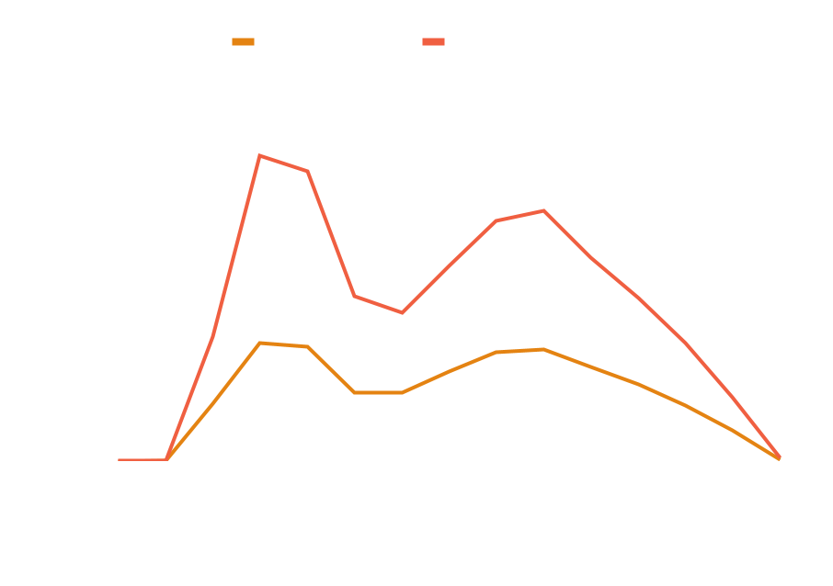
PEAK HOURS
12 PM: Peak Hour —--------------------------
Orders: 2,520
Quantity: 6,543
3 PM: Sales Dip —--------------------------
Orders: 1,468
Quantity: 3,170
6 PM: Evening Peak —--------------------------
Orders: 2,399
Quantity: 5,359

Slide 7

PEAK DAY
Peak Day —--------------------------
Friday
Orders: 3538
Quite Day —--------------------------
Sunday
Orders: 2624
Sale Trend —--------------------------
Sales rise as the week progresses

Slide 8
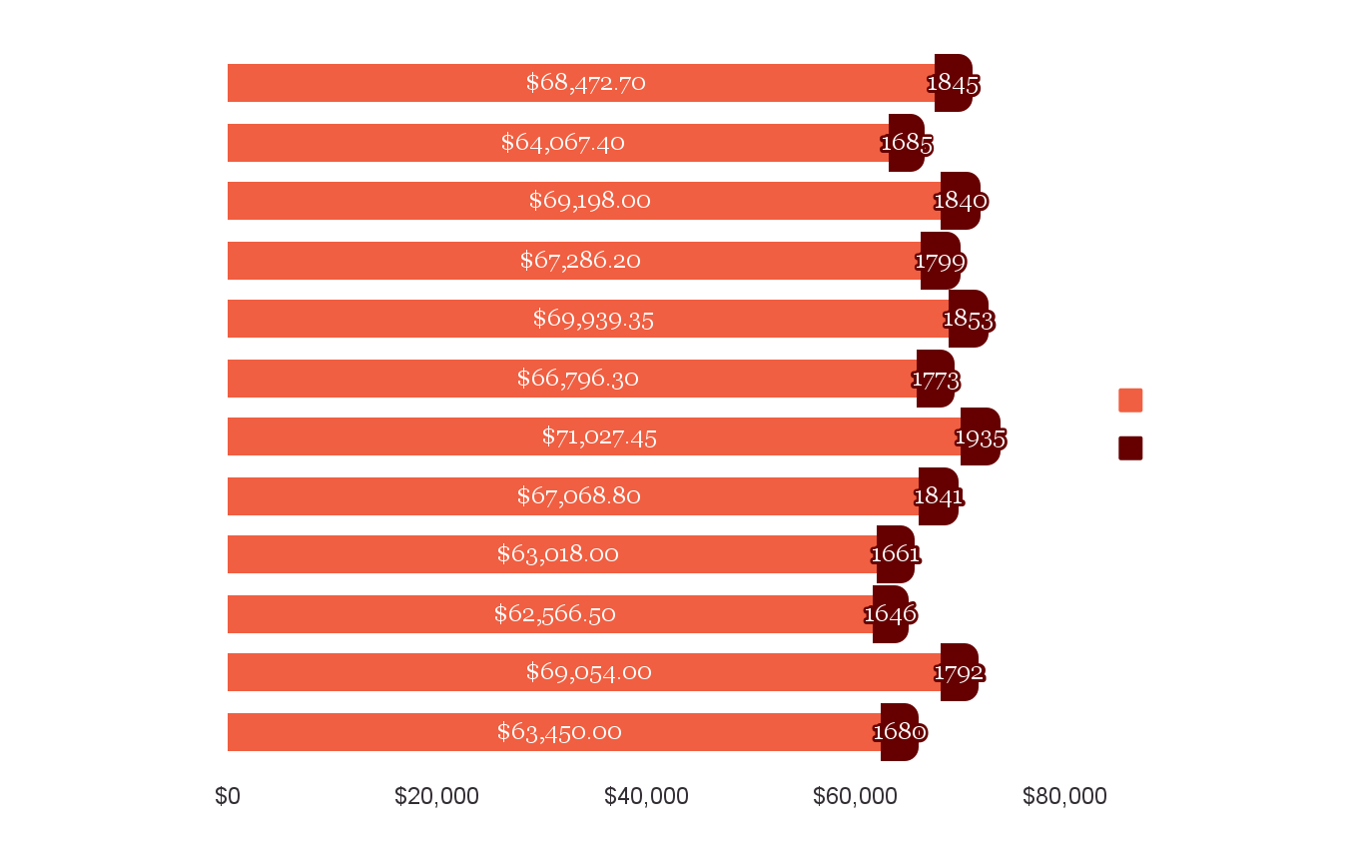
PEAK MONTH & REVENUE
Peak Month —--------------------------
July
Orders: 1935
Revenue: $71,027.45
Slow Month —--------------------------
October
Orders: 1646
Revenue: $62,566.50

Slide 9
CATEGORIES
30%
24.2%
23.5%
22.3%
Classic
Supreme
Veggie
Chicken
14888
Pizzas sold
11987
Pizzas sold
11649
Pizzas sold
11050
Pizzas sold

Slide 10

SALE BY SIZE
Most Popular Size —--------------------------
Large
Orders: 18956
Least Popular Size —--------------------------
Double Extra Large
Orders: 28

Slide 11
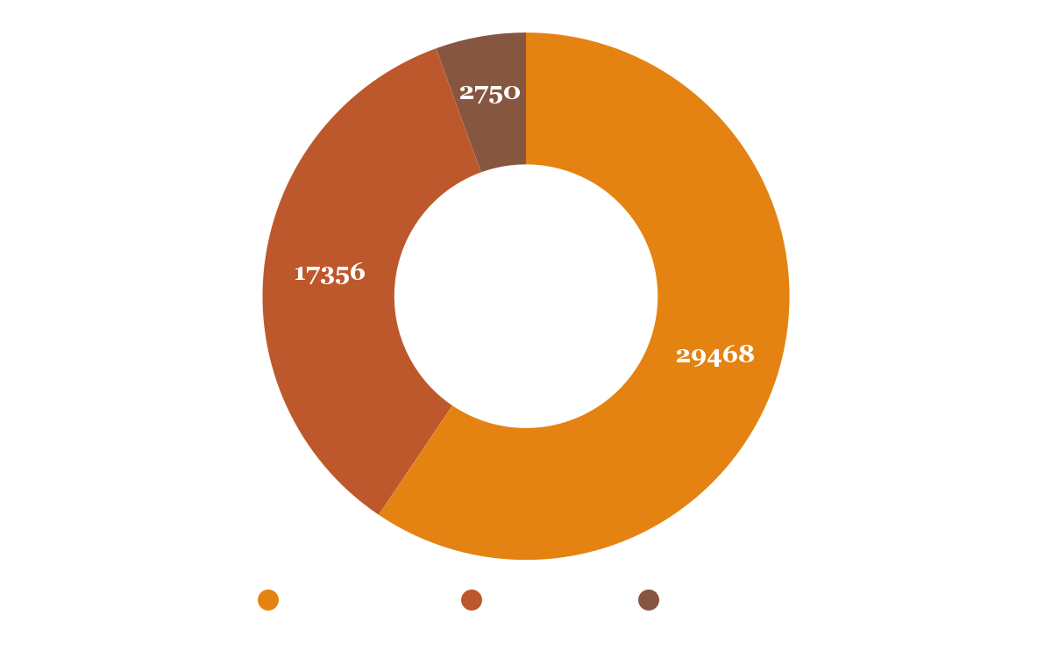
ORDER BY TIME OF DAY
Afternoon Peak —--------------------------
Peak Hour: 12 PM
Total Quantity: 29,468
Evening Peak —--------------------------
Peak Hour: 17 PM
Total Quantity: 17,356
Morning Peak —--------------------------
Peak Hour: 11 PM
Total Quantity: 2,750

Slide 12


TOP INGREDIENTS
01
03
05
Garlic
27422
Red Onions
19547
Mozzarella Cheese
10333
02
04
Tomatoes
26601
Red Peppers
16284

Slide 13






CUSTOMER ENGAGEMENT
Average Daily Customers
Total Orders
Total Pizzas Sold

Slide 14






FINANCIAL PERFORMANCE
Total Revenue
for 2015
Average Order Value
Average Cost per Pizza

Slide 15




ORDER DYNAMICS
Average Pizzas Per Order
Menu
Varieties

Slide 16






FUTURE OPTIMIZATIONS
Use points for discounts
Halloween-themed October
Shorten Sunday hours, B1G1 sales
Year-end customer feedback
Customer-designed pizzas
Half-and-half pizza option

Slide 17
THANK YOU
Author: Karen Judelyn Fernandes

